Slide 1


Building SPA’s using +
by Jose Barbosa | @kidchenko

Slide 2
Single Page Application
Notes:
Single Page Application(SPA) is a web application that fits on a single web page with dynamic actions without refreshing the page. Single Page Application interactions can be handle without reaching server.
SPA can improve performance in several ways like loading time, using AJAX, easy to navigate pages etc.
Users will be more comfortable with Single Page Application, It is very easy to navigate to different page and filter content.

Slide 3
“…In an SPA, either all necessary code – HTML, JavaScript, and CSS – is retrieved with a single page load, or the appropriate resources are dynamically loaded and added to the page as necessary, usually in response to user actions. The page does not reload at any point in the process…”

Slide 4
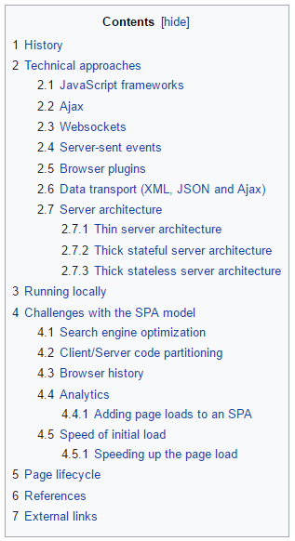
Benefits!?
Notes:
Benefits:
No extra queries to the server to download pages.
User friendly.
Performance Improvement, Single Page Application can improve performance in many ways, Single time file load each of HTML, CSS, JS.
SPAs did get adopted a lot over the last few years for building the private dashboard part of SaaS (Software as a Service) platforms or Internet services in general, as well as for building enterprise data-driven and form-intensive applications.

Slide 5
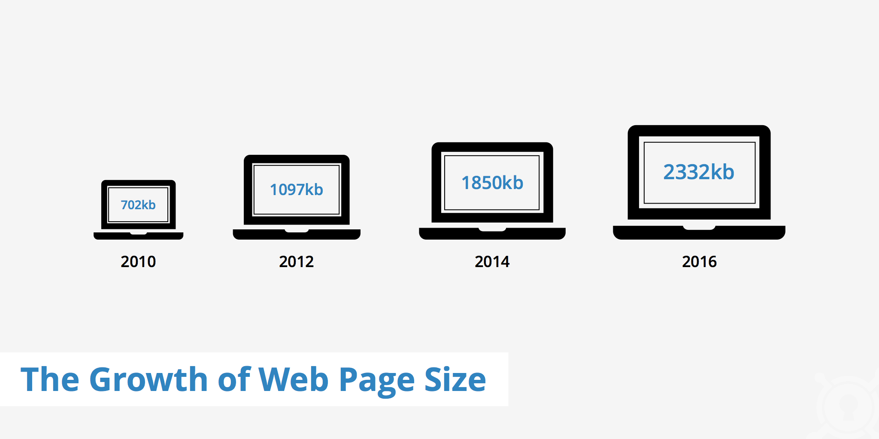

Slide 6
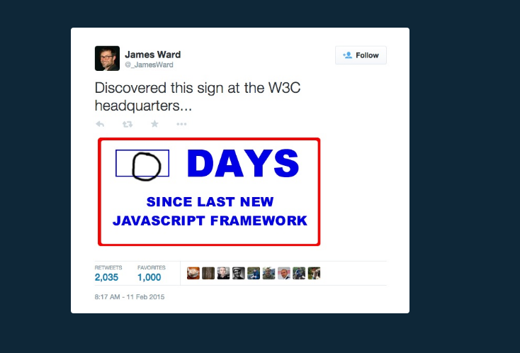
Notes:
days without accident sign
In the JavaScript community they create frameworks by accident

Slide 7

Notes:
days without accident sign
In the JavaScript community they create frameworks by accident

Slide 8

https://dayssincelastjavascriptframework.com/

Slide 9
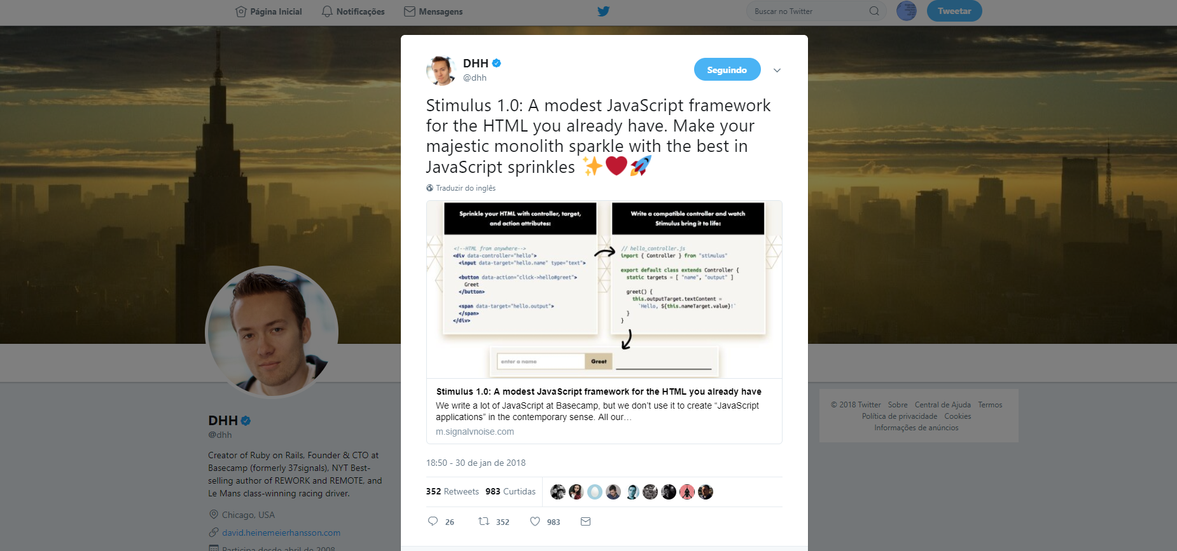

Slide 10

Notes:
SPAs não são nada novo! Apenas react é uma nova ferramenta para SPA

Slide 11


Slide 12
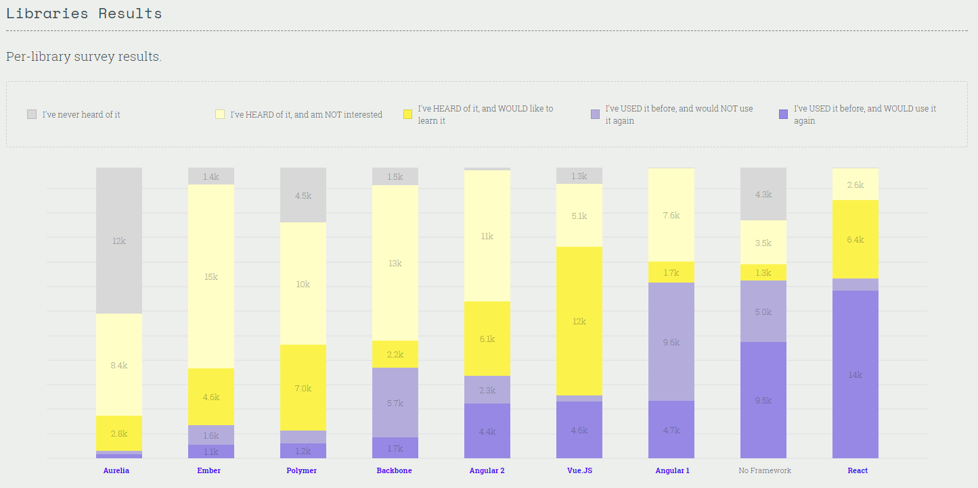
https://stateofjs.com/2017/front-end/results/

Slide 13
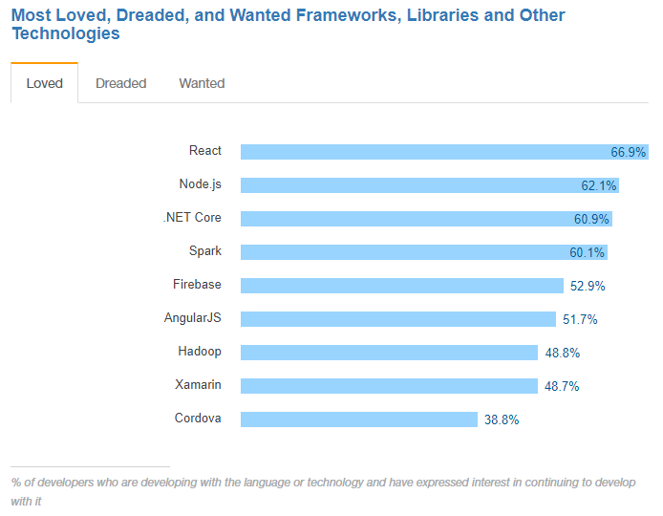
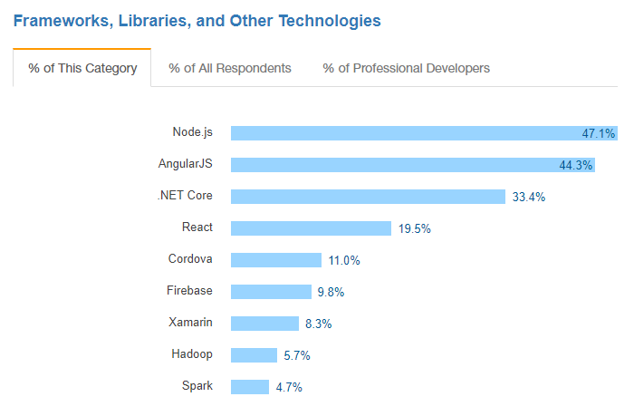
https://insights.stackoverflow.com/survey/2017#technology-most-loved-dreaded-and-wanted-frameworks-libraries-and-other-technologies
https://insights.stackoverflow.com/survey/2017#technology-frameworks-libraries-and-other-technologies

Slide 14


Slide 15


Slide 16








Software Engineer at Jetabroad; Agile Advocate (Scrum/Lean); Digital Entrepreneur; JavaScript Lover; C# Lover; Ex-Lambda3 from Brazil; Crazy `Farang`
OLÁ!
@kidchenko
github.com/kidchenko

Slide 17



Slide 18


Slide 19
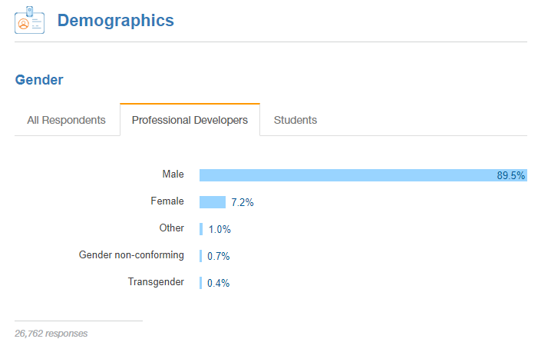
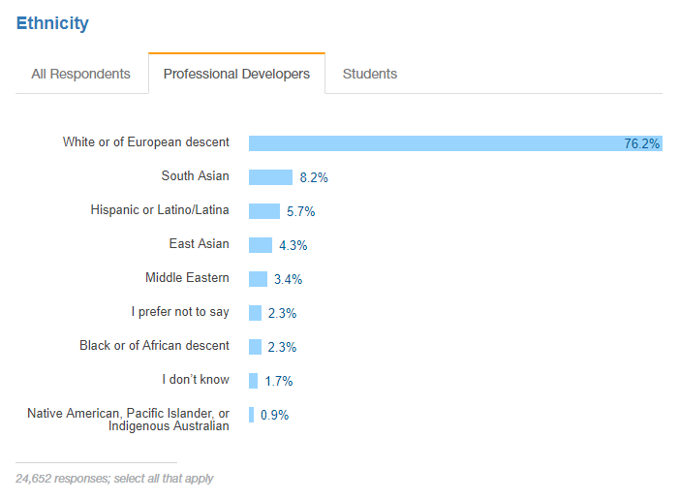

Slide 20
Building SPA’s using +

Slide 21
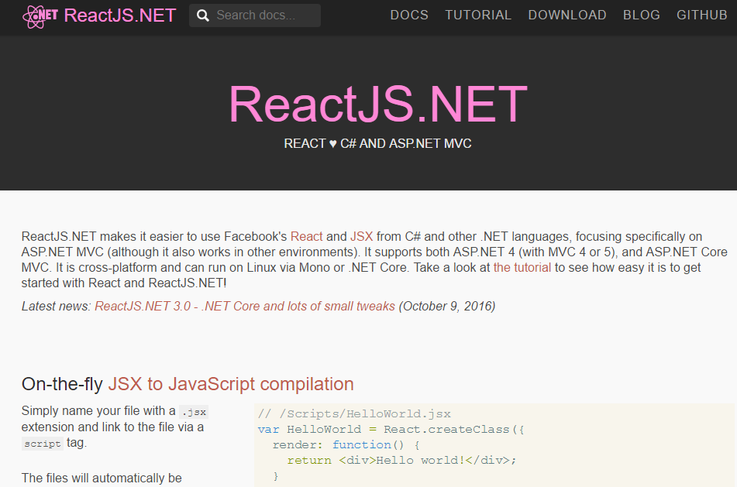
Nops!

Slide 22
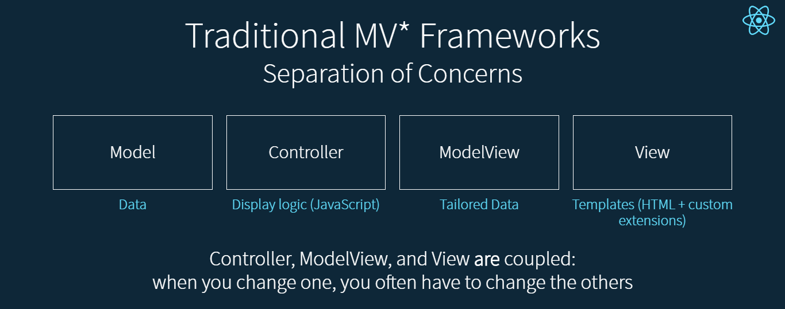

Slide 23
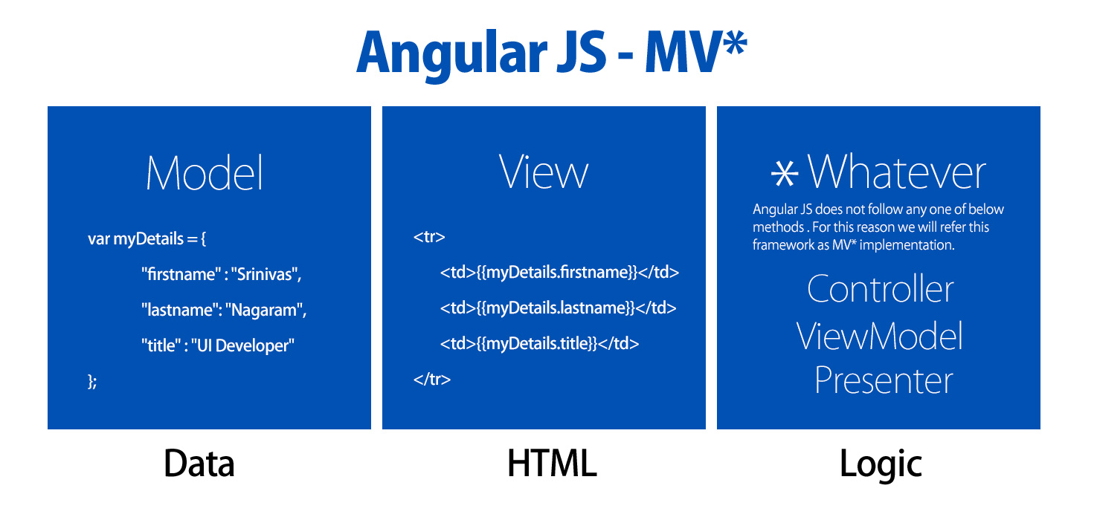

Slide 24
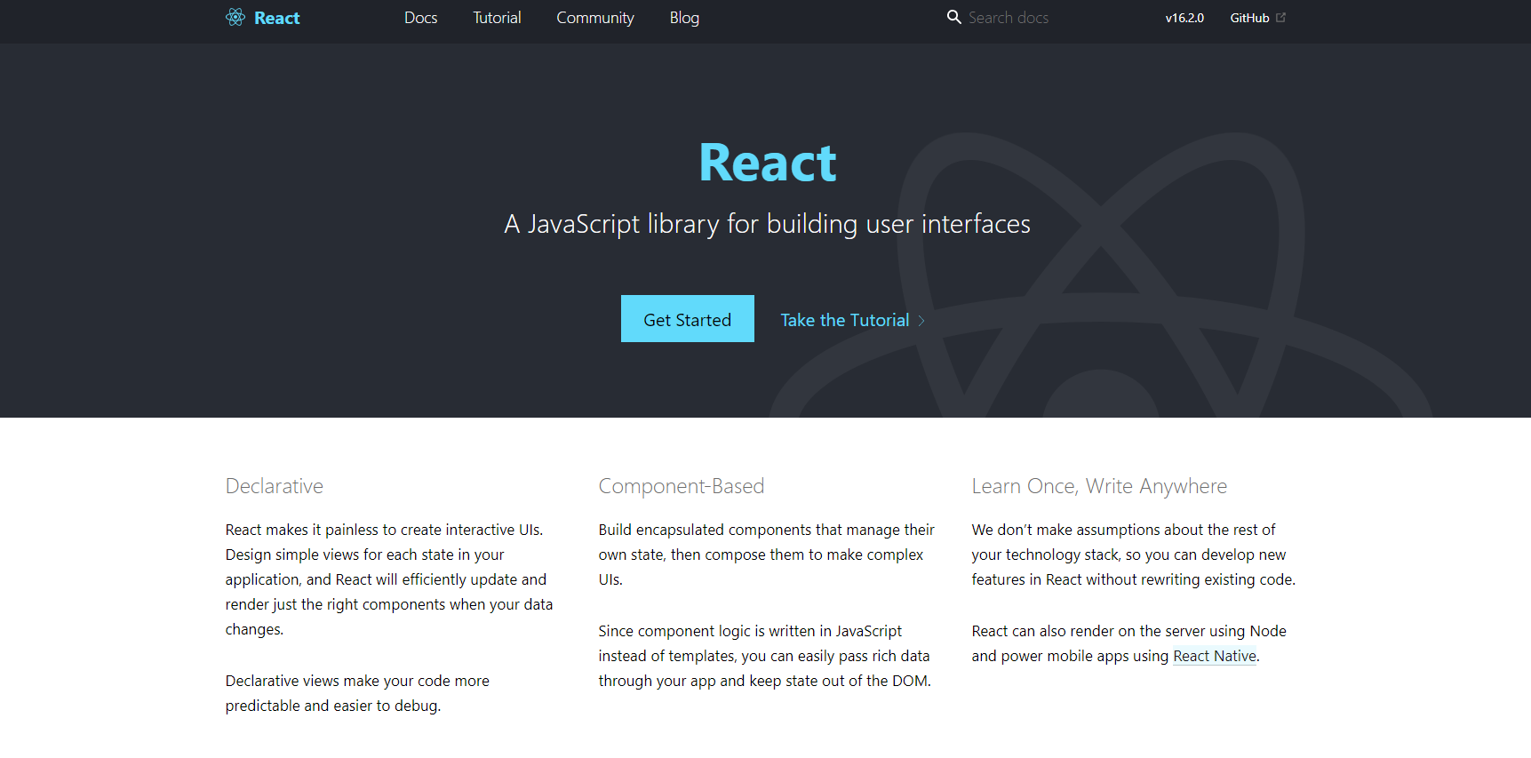
https://reactjs.org/

Slide 25


Slide 26
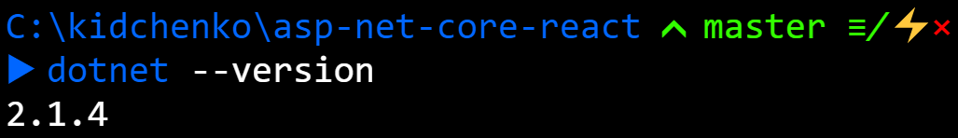
https://dot.net

Slide 27
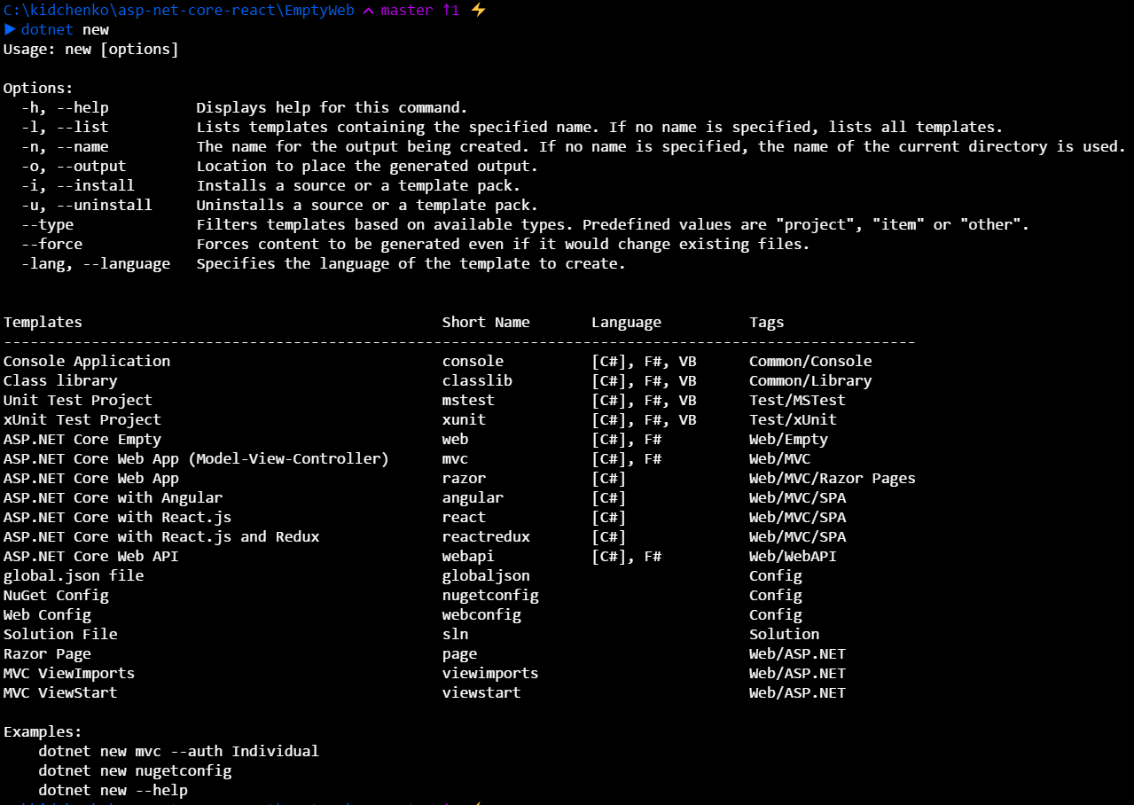
Notes:
Dotnet core are just console apps, in the main, we build our web host and run to start listening from request.

Slide 28
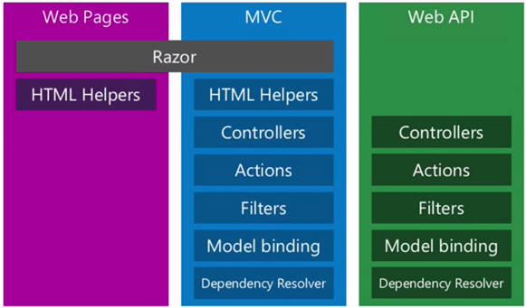
SPA
Notes:
3 frameworks, similar but different. Each of these frameworks works great for what they are built for but there is a lack of alignment.
Web Pages and MVC both use razor. Share HTML Helpers, MVC and Web API is more similar, share a lot of stuffs.

Slide 29
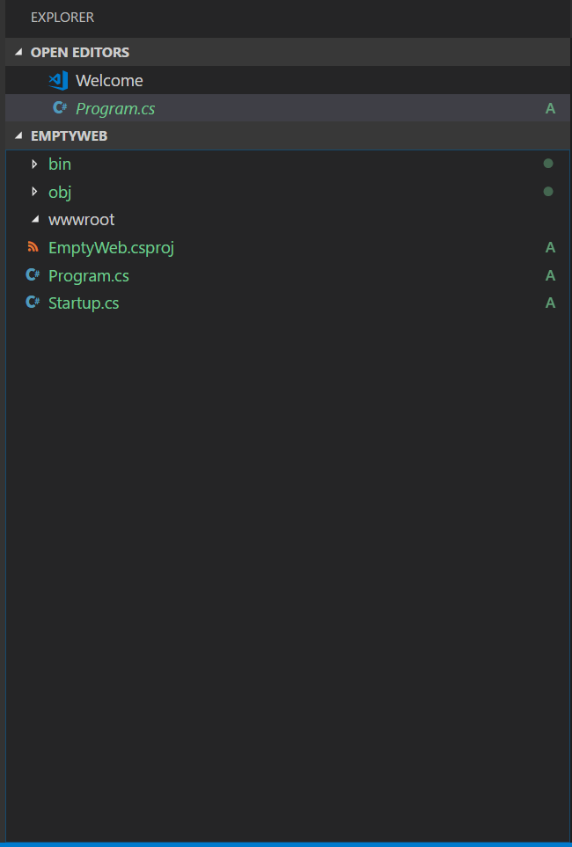
web root directory

Slide 30
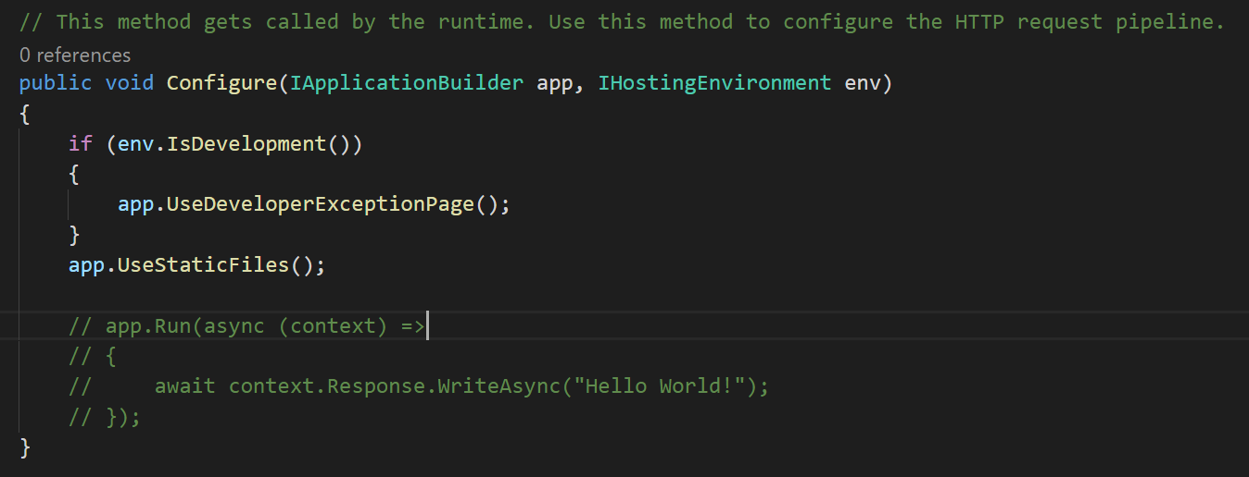
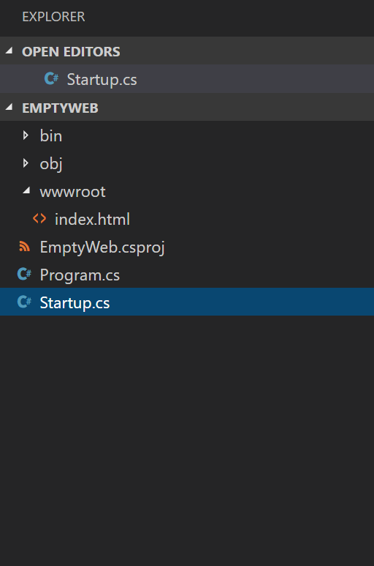
Static files: HTML, CSS, JavaScript

Slide 31
<!DOCTYPE html>
<html>
<head>
<script src="https://unpkg.com/react@16/umd/react.development.js"></script>
<script src="https://unpkg.com/react-dom@16/umd/react-dom.development.js"></script>
<script src="https://unpkg.com/babel-standalone@6.15.0/babel.min.js"></script>
</head>
<body>
<div id="root"></div>
<script type="text/babel">
ReactDOM.render(
<h1>Hello, world!</h1>,
document.getElementById('root')
);
</script>
</body>
</html>

Slide 32
<!DOCTYPE html>
<html>
<head>
<script src="https://unpkg.com/react@16/umd/react.development.js"></script>
<script src="https://unpkg.com/react-dom@16/umd/react-dom.development.js"></script>
<script src="https://unpkg.com/babel-standalone@6.15.0/babel.min.js"></script>
</head>
<body>
<div id="root"></div>
<script type="text/babel">
ReactDOM.render(
<h1>Hello, world!</h1>,
document.getElementById('root')
);
</script>
</body>
</html>

Slide 33


Slide 34
A JavaScript Library

Slide 35
For creating User Interfaces

Slide 36
Using Components
Notes:
Components are the single building block of react library

Slide 37
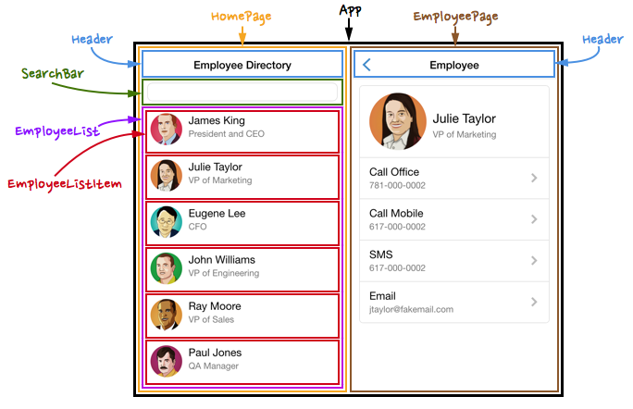
C o m p o n e n t s

Slide 38
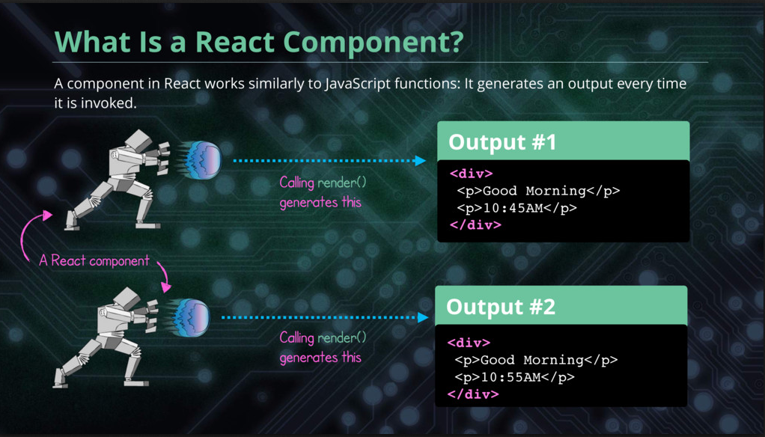

Slide 39
A Component do 3 things:
Notes:
Components are the single building block of react library

Slide 40
A Component do 3 things:
Render
Receive Props
Maintain State
Notes:
Components are the single building block of react library

Slide 41
JSX
Notes:
JSX is a preprocessor step that adds XML syntax to JavaScript. You can definitely use React without JSXbut JSX makes React a lot more elegant. Just like XML, JSX tags have a tag name, attributes, and children

Slide 42
Controllers

Slide 43
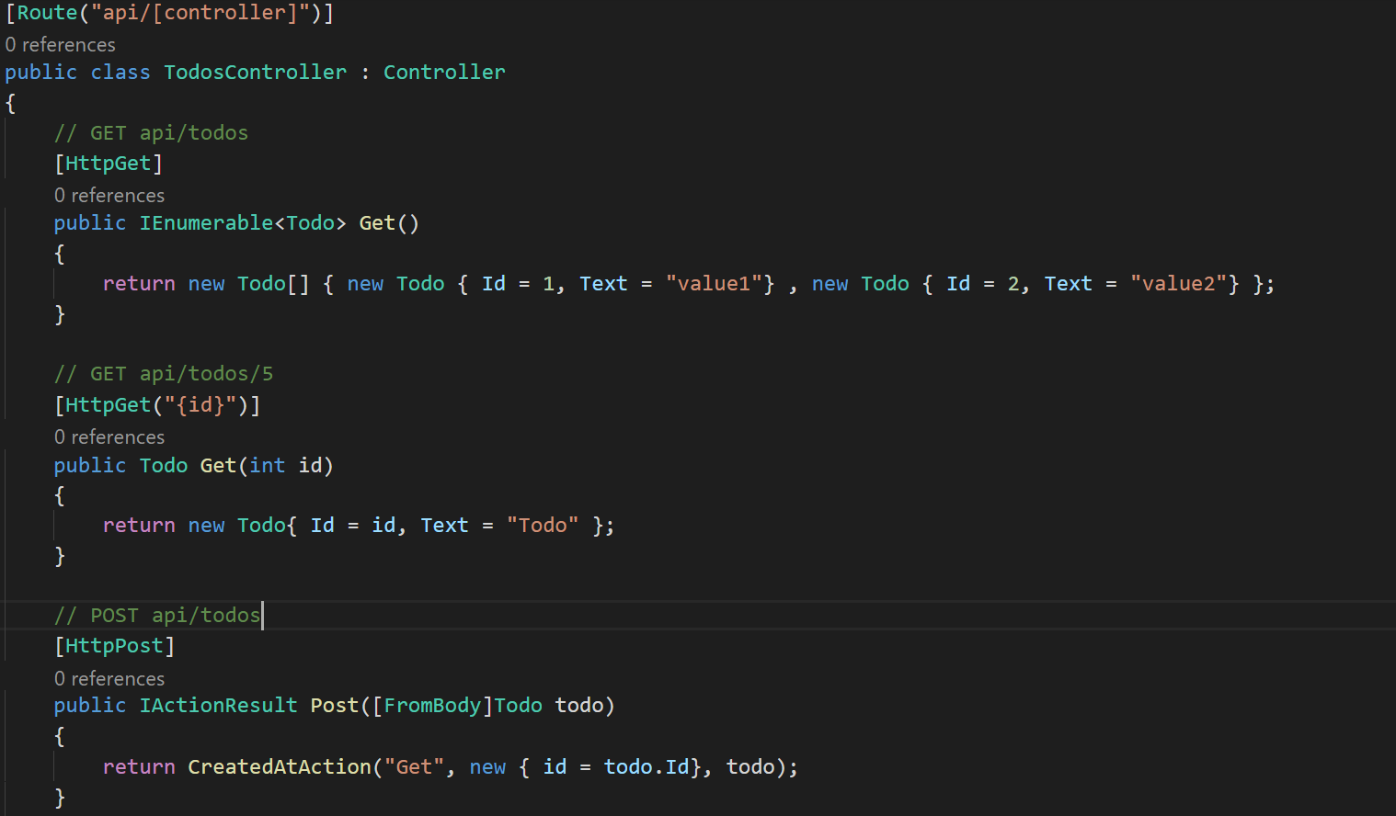
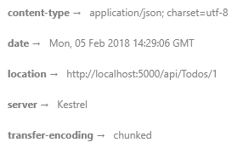
Routing
Return code 201
and add
location header
Data coming from JSON

Slide 44


Slide 45
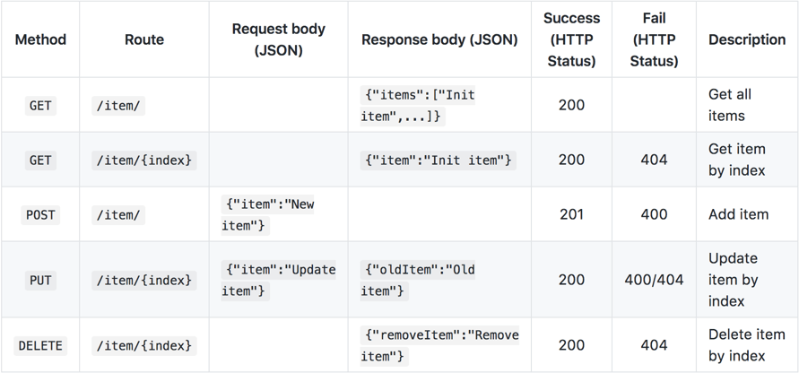

Slide 46
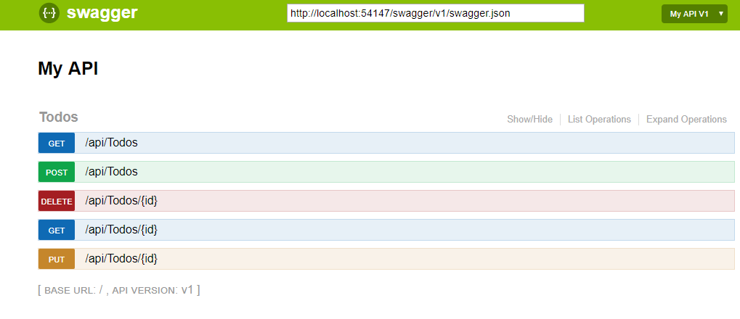
dotnet add package Swashbuckle.AspNetCore --version 1.1.0

Slide 47


Slide 48
Virtual DOM

Slide 49
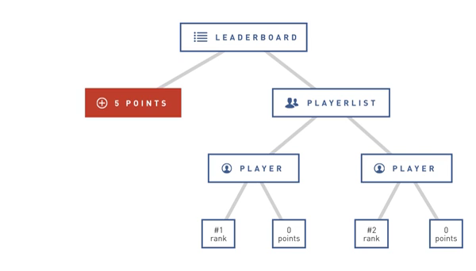

Slide 50
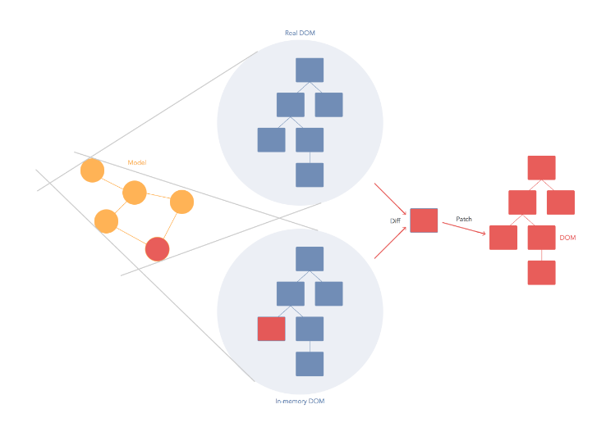

Slide 51
Composition

Slide 52
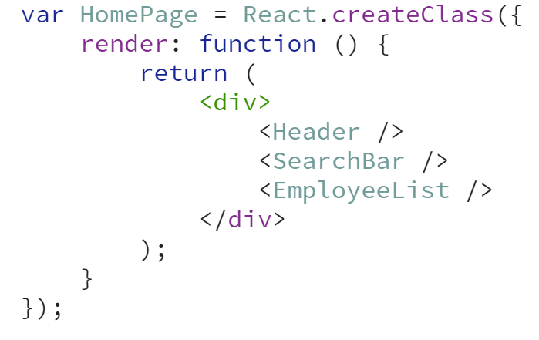

Slide 53
Tooling

Slide 54
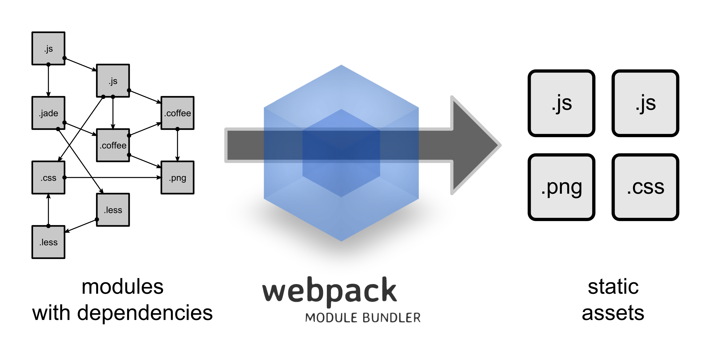

Slide 55
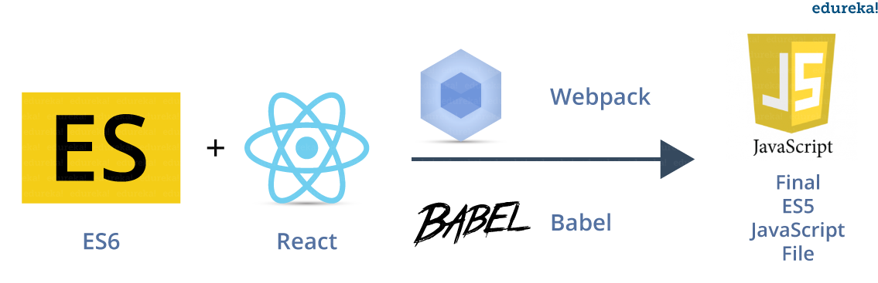

Slide 56
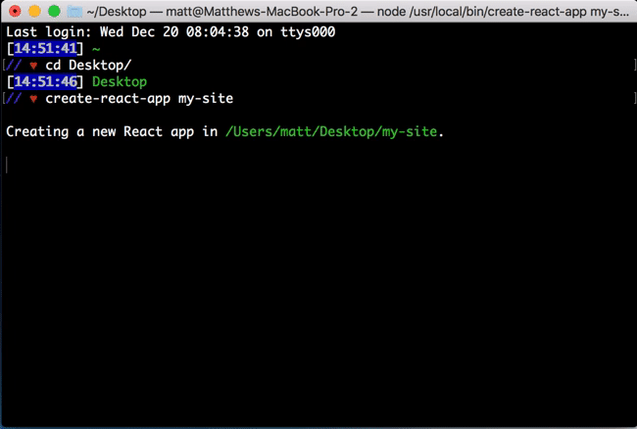

Slide 57
Thank you! Obrigado! Gracias! Khob khun krab! Questions?
@kidchenko
github.com/kidchenko

